Slide 1
Selecting a Target Area
Three Primary Factors to Assess
Henry Vosburgh, Midwest Church Extension

Slide 2
The Shape of MCESP
Core Values
Specific Goals
Purpose
Objectives
Distinctives

Slide 3
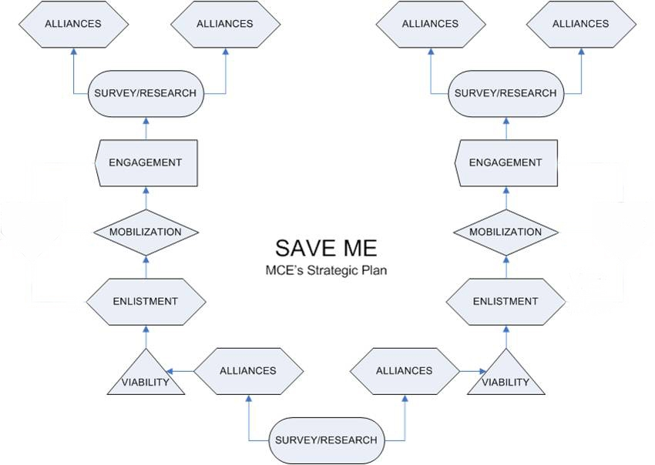

Slide 4
Viability Assessment
PRIORITIZING TARGETS
Un-churched population
Degree of Gospel witness and ministry
Potential for networking
Presence of a "core group"
"Macedonian Call"
Other, including Subjective
factors and Divine Direction.
Divine
Direction
Objective
Factors
Subjective
Factors
Priority Target

Slide 5
Selecting a Target Area:
Three Primary Factors to Assess
Assess for Specific Profiles
Assess for Networking Potential
Assess for Strategic Value

Slide 6
Assess for Specific Profiles
Geographic / Demographic Profile
What fields are open?

Slide 7
MCE Country
~ 46.2 Million people.
1/7 of U.S . population

Slide 8
Assess for Specific Profiles
Geographic / Demographic Profile
What fields are open?
Who lives there?
Is the field option growing / static / in
decline?
Is the field rural / suburban / urban?

Slide 9
Assess for Specific Profiles
B. Area Spiritual / Religious Profile
What is the religious representation?
What is the degree of religious commitment?
Ratio of biblical witness v. the population
statistic
How much IFCA doctrine / values present
How much Gospel accuracy / activity is
evident
What is the level of healthy spiritual
character of testimony?

Slide 10
Assess for Specific Profiles
Personal / Team Compatibility Profile
Field >>> Plant Leader Selection
What kind of leader can thrive in a given
area?

Slide 11
Assess for Specific Profiles
Personal / Team Compatibility Profile
2. Plant Leader >>> Field Selection
Are you the kind of leader to serve in a
given area?
Planter or Waterer?
All plant leaders must profile as builders!
Family needs?
Health, Skills, Equipping?

Slide 12
II. Assess for Network Potential
Use of network assets is dependent on
degree of proximity
Presumptive Consideration:
Familiarity ratio to burden
improves with proximity.

Slide 13
III. Assess for Strategic Value
Great Commission coverage
Risk / Reward:
Does establishing this witness lead to more
advancement?

